Slide 1


Slide 2
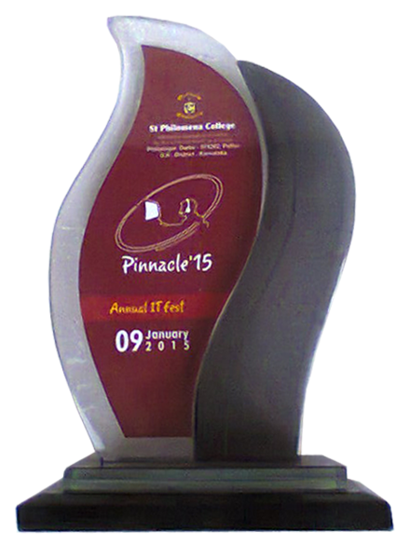
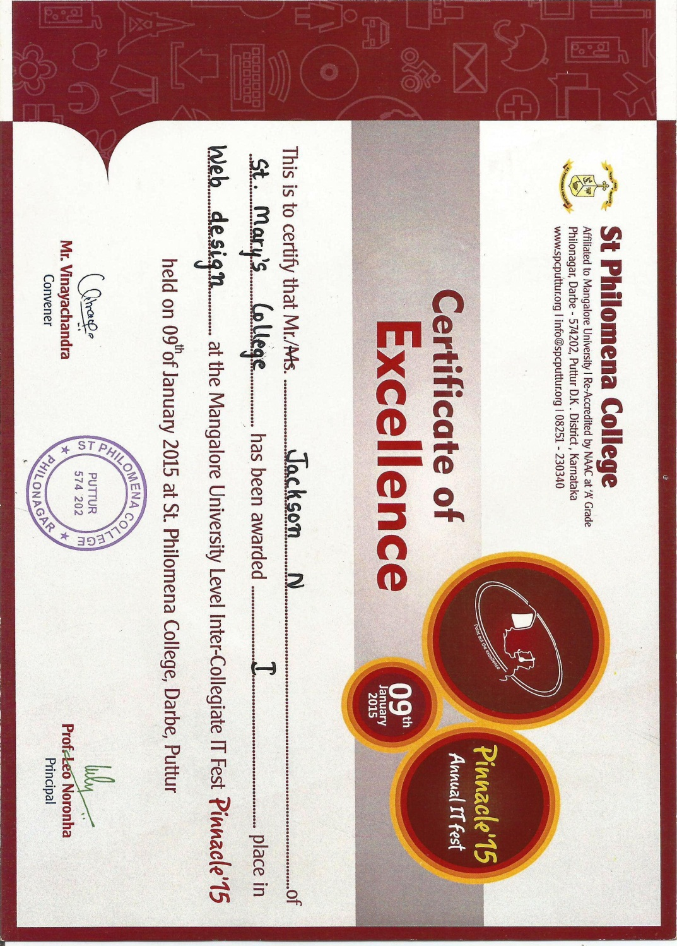
1st Place at Pinnacle – 15 University Level I.T. Fest
St. Philomena College, Puttur

Slide 3
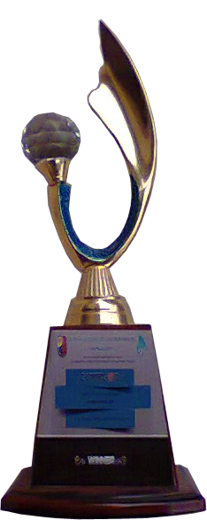
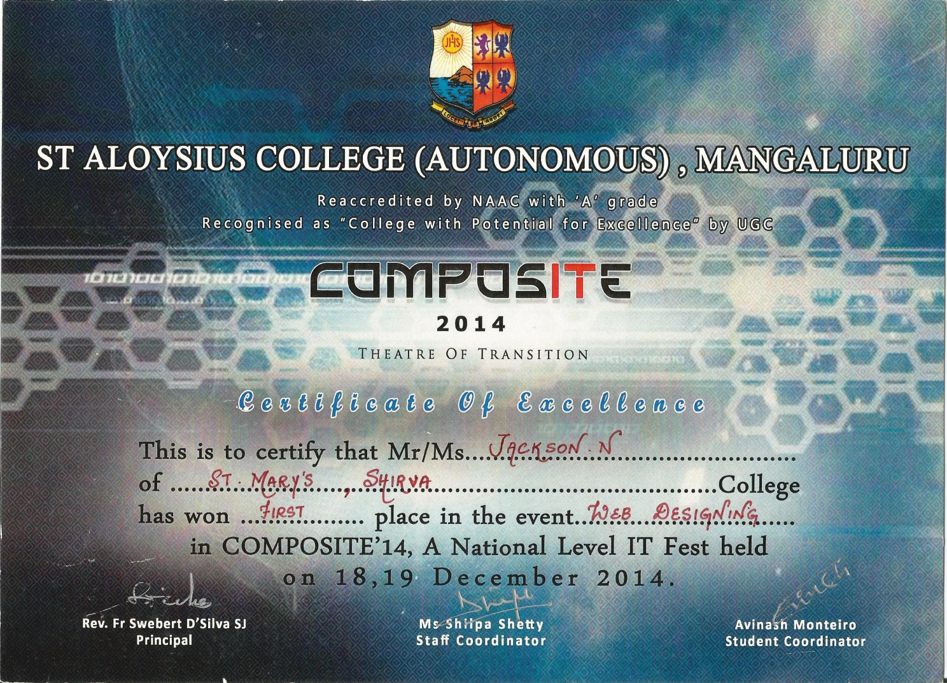
1st Place in Web Designing
at Composite-14 National Level I.T. Fest
St. Aloysius College, Mangaluru

Slide 4
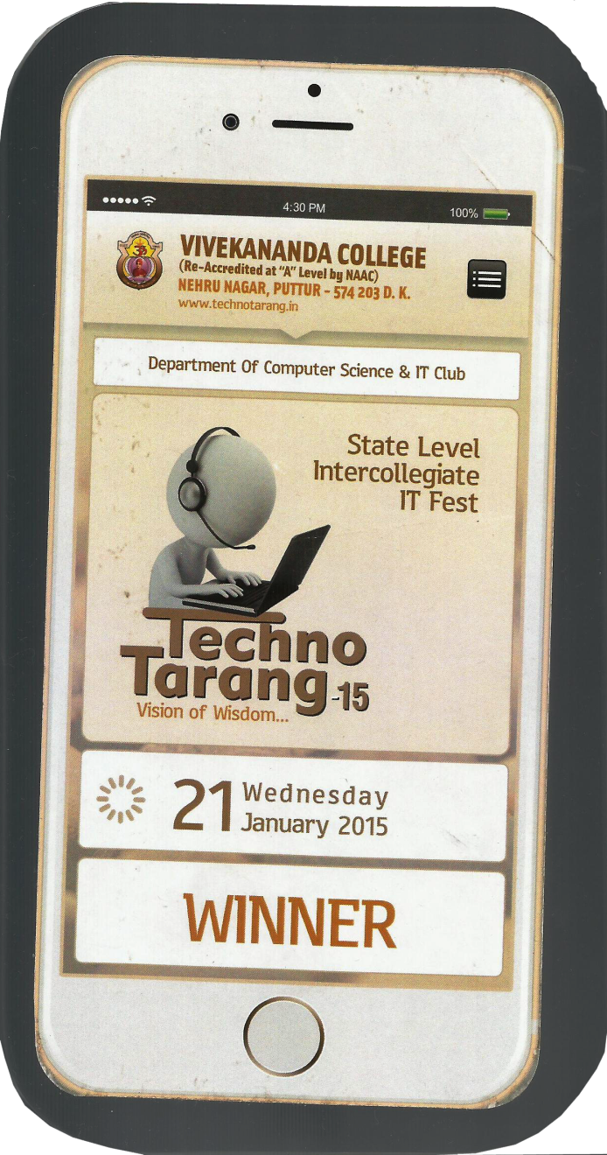
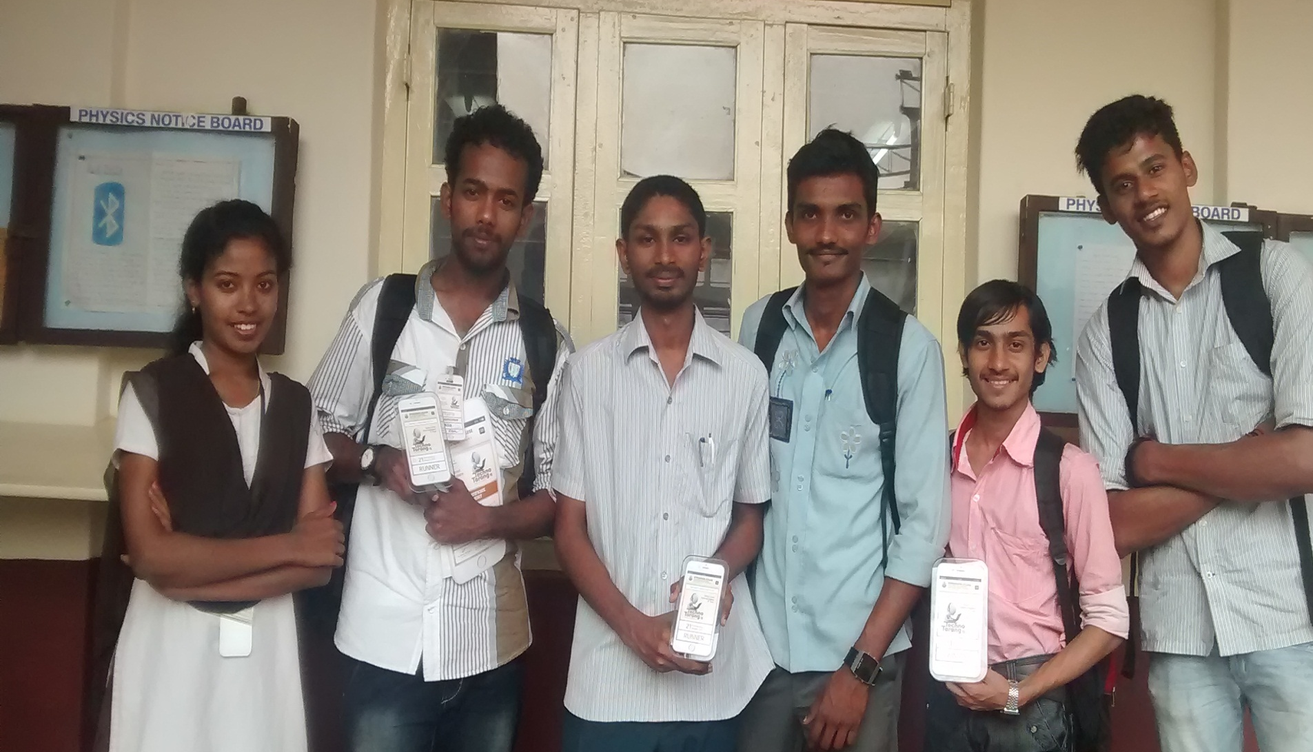
1st Place in Web Designing
at Techno Tarang-15 State Level I.T. Fest
Vivekananda College, Puttur

